Slide 1
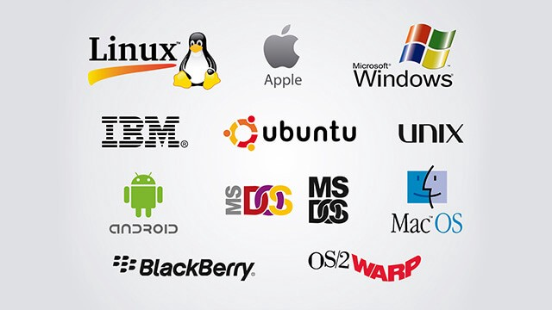
DEPARTMENT OF CSE(AIML)
SEM IV
Prof. Odilia Gonsalves

Slide 2
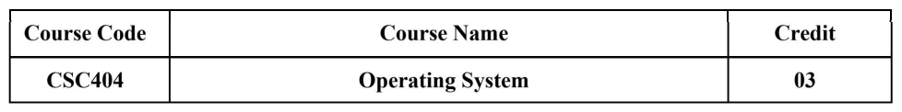

Slide 3
Course Objectives:
1. To introduce basic concepts and functions of operating systems.
2. To understand the concept of process, thread and resource management.
3. To understand the concepts of process synchronization and deadlock.
4. To understand various Memory, I/O and File management techniques.

Slide 4
Course Outcome:
At the end of the course student should be able to
Explain the objectives, functions, shell, kernel, system call and structure of Operating system.
Evaluate performance of process scheduling algorithms.
Apply the concepts of synchronization and deadlocks
Evaluate performance of Memory allocation and replacement policies.
Explain the concepts of file management.
Analyze techniques of disk scheduling for disk management.

Slide 5
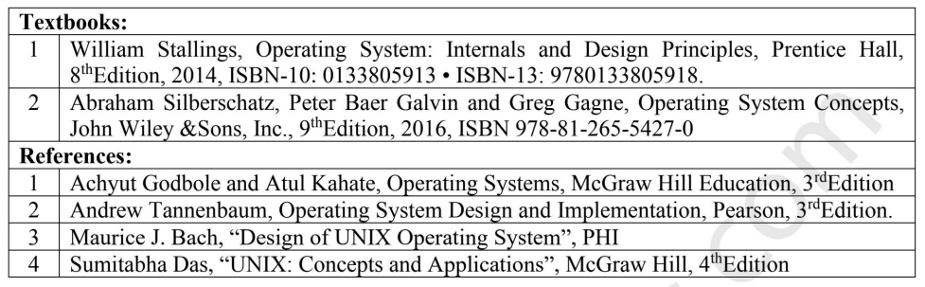

Slide 6
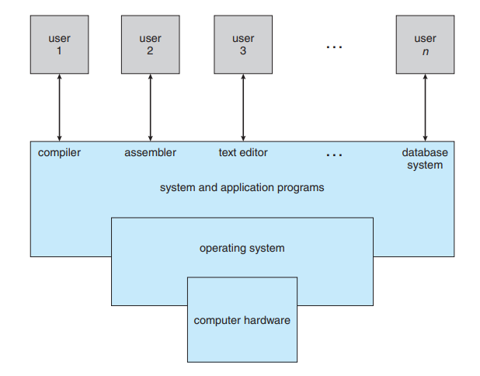
Introduction

Slide 7
OBJECTIVES AND FUNCTIONS
An OS is a program that controls the execution of application programs and acts as an interface between applications and the computer hardware.
It can be thought of as having three objectives:
• Convenience: An OS makes a computer more convenient to use.
• Efficiency: An OS allows the computer system resources to be used in an efficient manner.
• Ability to evolve: An OS should be constructed in such a way as to permit the effective development, testing, and introduction of new system functions without interfering with service.

Slide 8
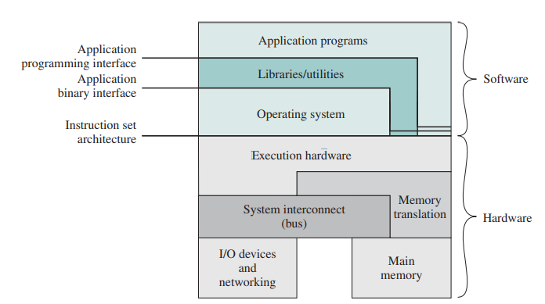

Slide 9
Briefly, the OS typically provides services in the following areas:
• Program development:
• Program execution:
• Access to I/O devices:
• Controlled access to files:
• System access:
• Error detection and response:
• Accounting:
• Instruction set architecture (ISA) :
• Application binary interface (ABI) :
• Application programming interface (API):

